Slide 1
Aırport system
Gülşah Ölmez(63180002)
Muhammed Emin Oral (63180006)
Selin Eraslan(63180039)
Serhan Karpuz(63180053)

Slide 2
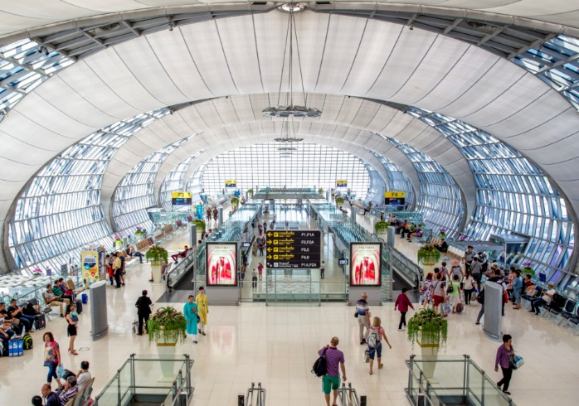
abstract
The main theme of our project will be around the departure area of an airport. It is common for passengers to lose time at the airport in checking area. Some may even miss the flight in which they bought. Also, weight luggage’s and bags are another time-consuming consideration. To please all passengers, it is important to minimize airport waiting times and maximize the efficiency of an airport staff.

Slide 3
Components of the system
System: Airport
Entities: Passengers, Airport personnel
Attributes for passengers: Arrival time for domestic terminal, Arrival time for international terminal, Required service for domestic terminal, Required service for international terminal
Attributes for personnel: Service time for domestic terminal employee, Service time for international terminal employee

Slide 4
Components of the system
Activities: Service , service time(domestic and international terminal employee), interarrival time (pasennger in domestic and international terminal)
Events: Starting the service, Ending the service, Arrival, Departure, domestic and international terminal
State Variables: Status of personnel (busy or idle), Status of passenger (wait or not)
Output variables: Number of passengers who wait in the system.

Slide 5
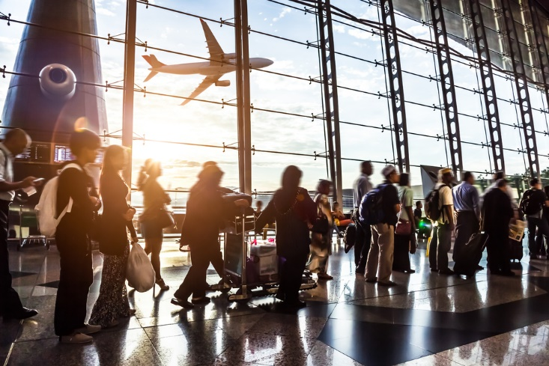
Objective of the system
Maximize customer satisfaction by minimizing the waiting time and the number of people waiting in the system. These conditions are provided by optimizing the number of reservations to be made and allowing a certain number of people to get in airport during the day.

Slide 6
Data collectıon
Stochastic Datas:
Interarrival times for the passengers both domestic and international terminal .
Service time for employee both domestic and international terminal.
Deterministic Data:
Number of airport personel.

Slide 7
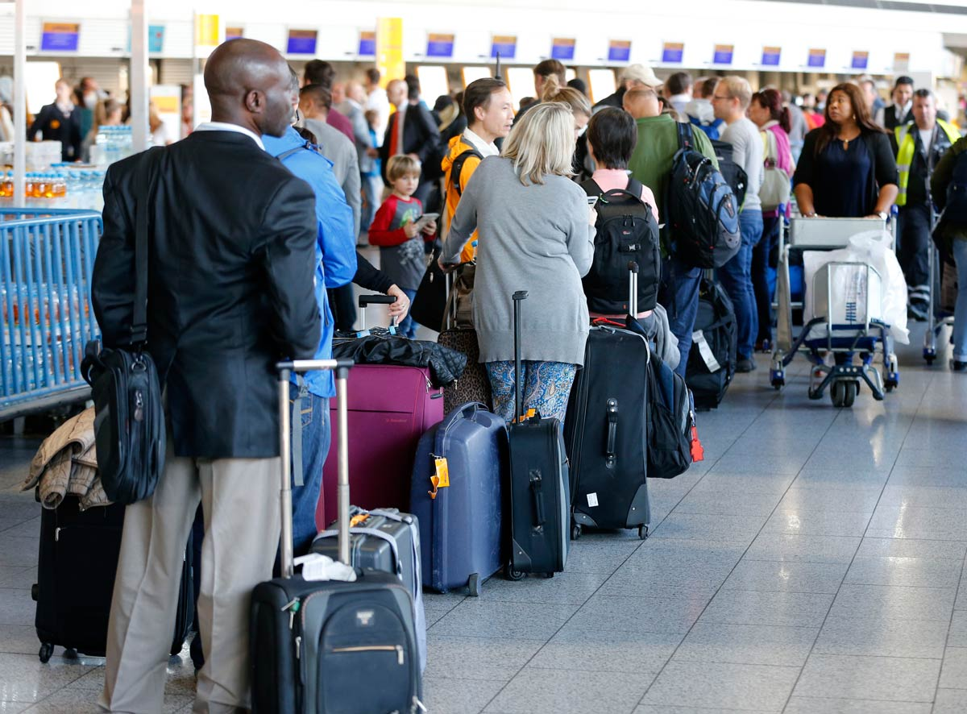
Data collectıon
Since real data could not be reached in this model made for airport ticket or baggage queue, random values were studied. Input analyzer was used to calculate the time interarrivals of the waiting passenger and the service times of the airport personnel both domestic and international terminal.

Slide 8
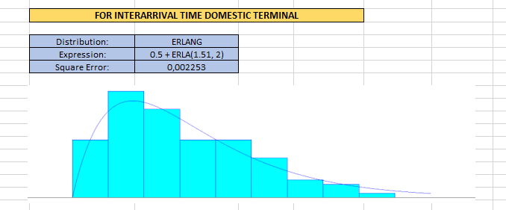
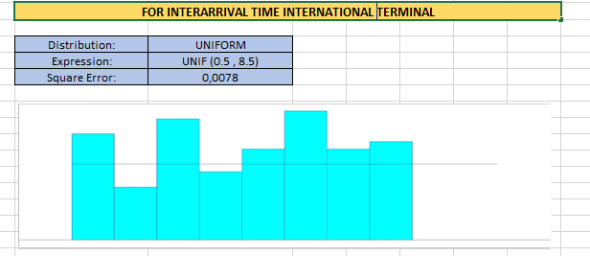
dıstrıbutıon determınatıon usıng ınput analyzer
First of all, distribution was determined in the input analyzer for passenger interarrival time for domestic and international terminal.

Slide 9
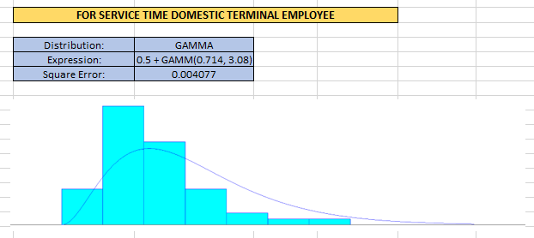
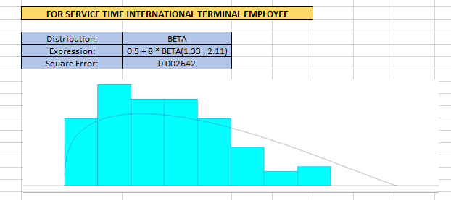
dıstrıbutıon determınatıon usıng ınput analyzer
The service time distributions of the airport employees were determined for both international and domestic terminal.

Slide 10
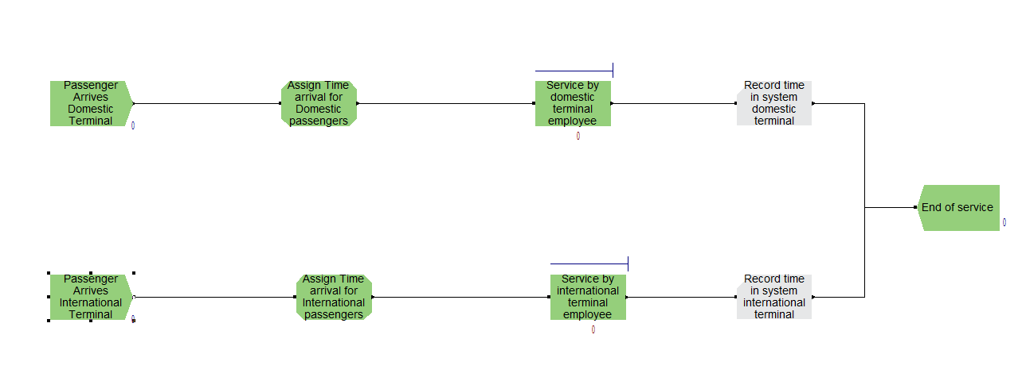
Arena model

Slide 11
Arena model
Two separate create modules for the passenger arrivals domestic terminal and the passenger arrivals international terminal were created with the distirbution values found by input analysis.
Separate assign modules are assigned to these two separate create modules.
Using the distributions of the service times determined by the input analysis, two separate process modules for the service by domestic terminal employee and the service by international terminal employee were connected to the assign.
The times of the events passed in the system were kept with the record models connected to the process modules.
Finally, these separate entities leave the system with the common dispos model.

Slide 12
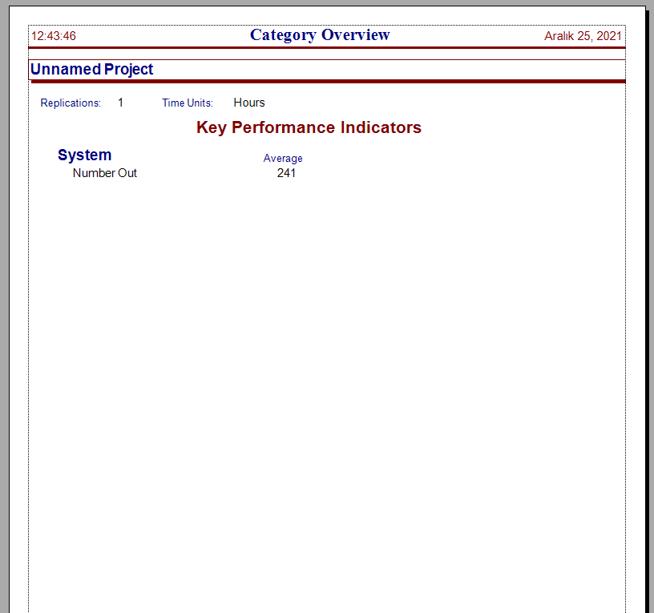
Arena results
Category Overview

Slide 13
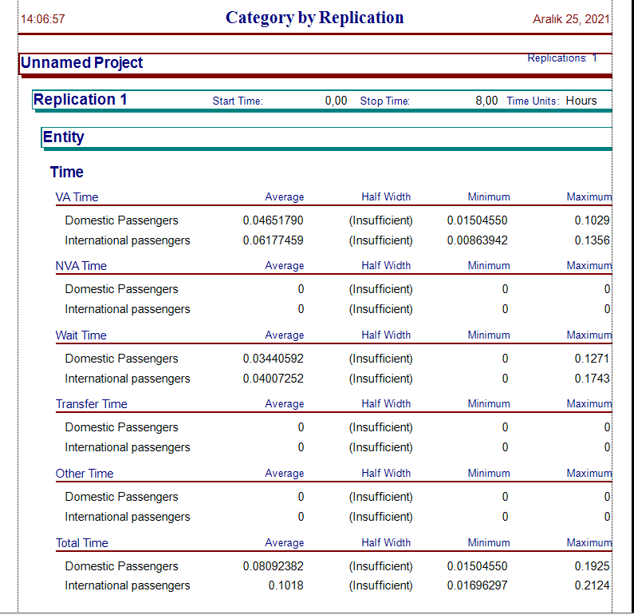
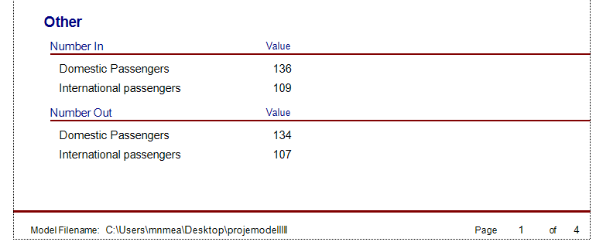
Arena results
Category by Replication
VA time
Domestic passengers: 2.8 minutes
International passengers: 3.7 minutes
Wait time
Domestic passengers: 2.1 minutes
International passengers: 2.4 minutes
Total time
Domestic passengers: 4.9 minutes
International passengers: 6.1 minutes

Slide 14
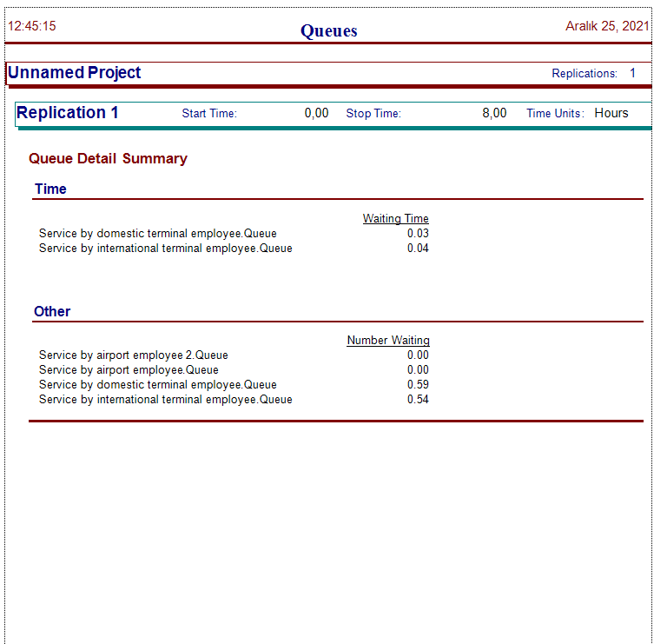
Arena results
Queues

Slide 15
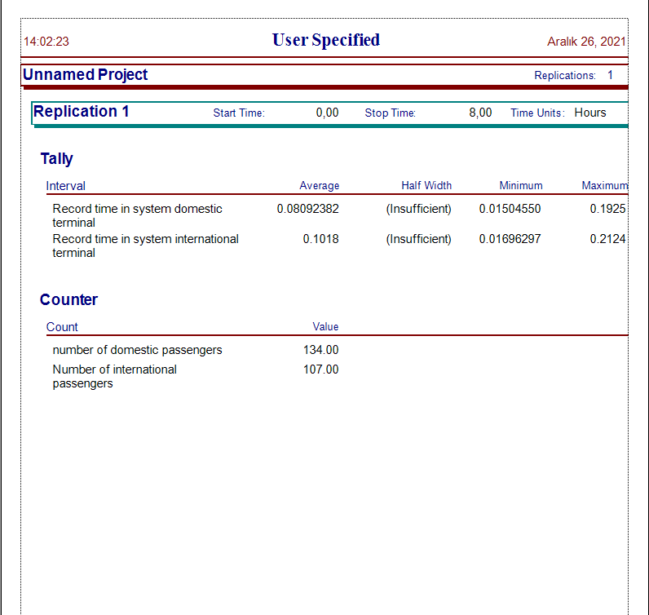
Arena results
User Specified
Record time in system domestic terminal average: 4.9 minutes
Record time in system international terminal average: 6.1 minutes

Slide 16

Output analysıs
Output analysis was used for the analysis of the collected arena results and gives statistical information.

Slide 17
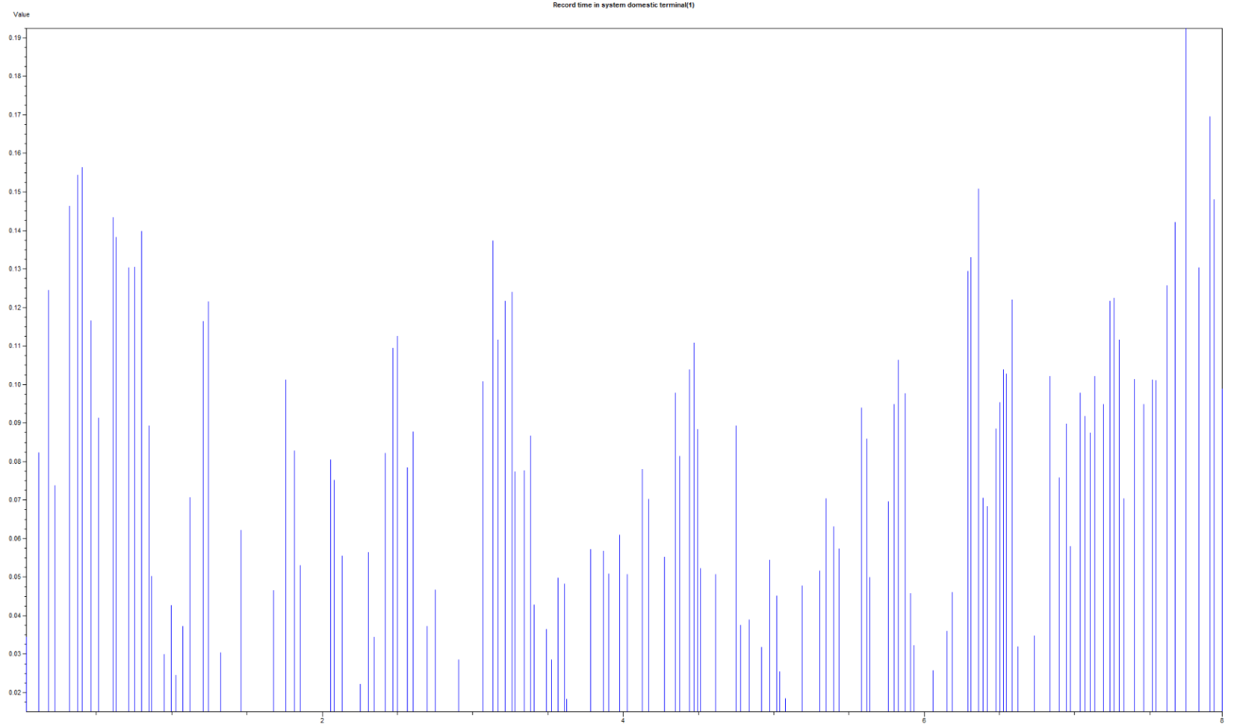
Output analysıs
Ouput analysis examines the data produced in the simulation and creates a bar chart of the data.
The bar chart on the side is the chart of the time spent by the domestic passengers in the system.

Slide 18
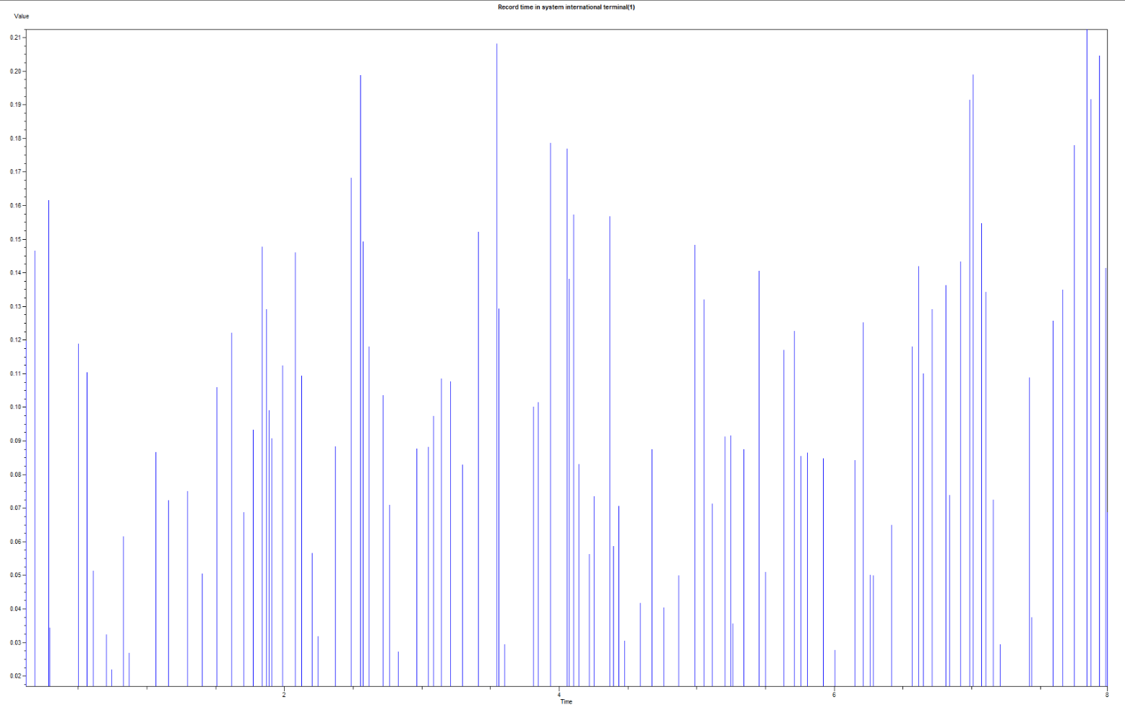
Output analysıs
The bar chart on the side is the chart of the time spent by the international passengers in the system.

Slide 19
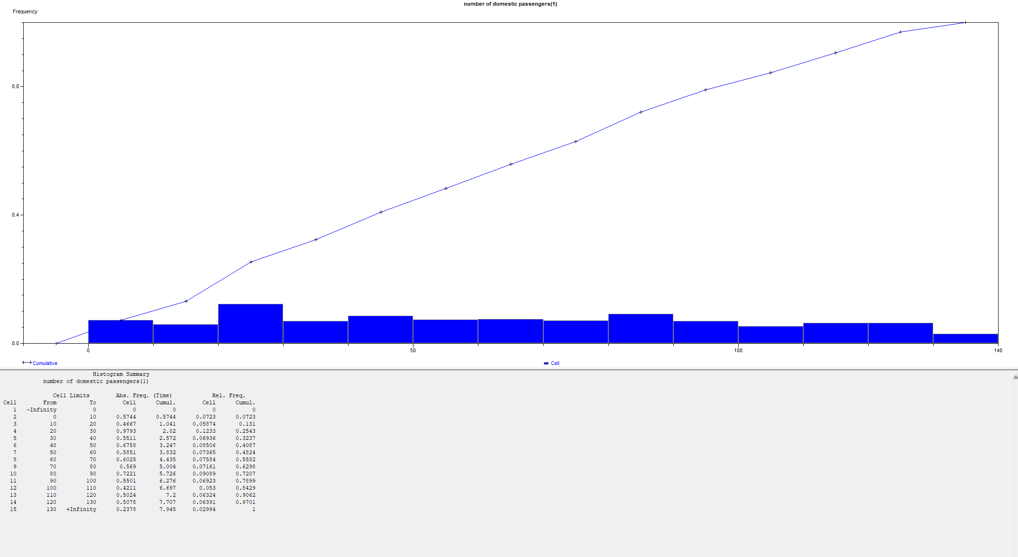
Output analysıs
A histogram was created with the numbers of
domestic passengers.
Number of Domestic Passengers Histogram

Slide 20
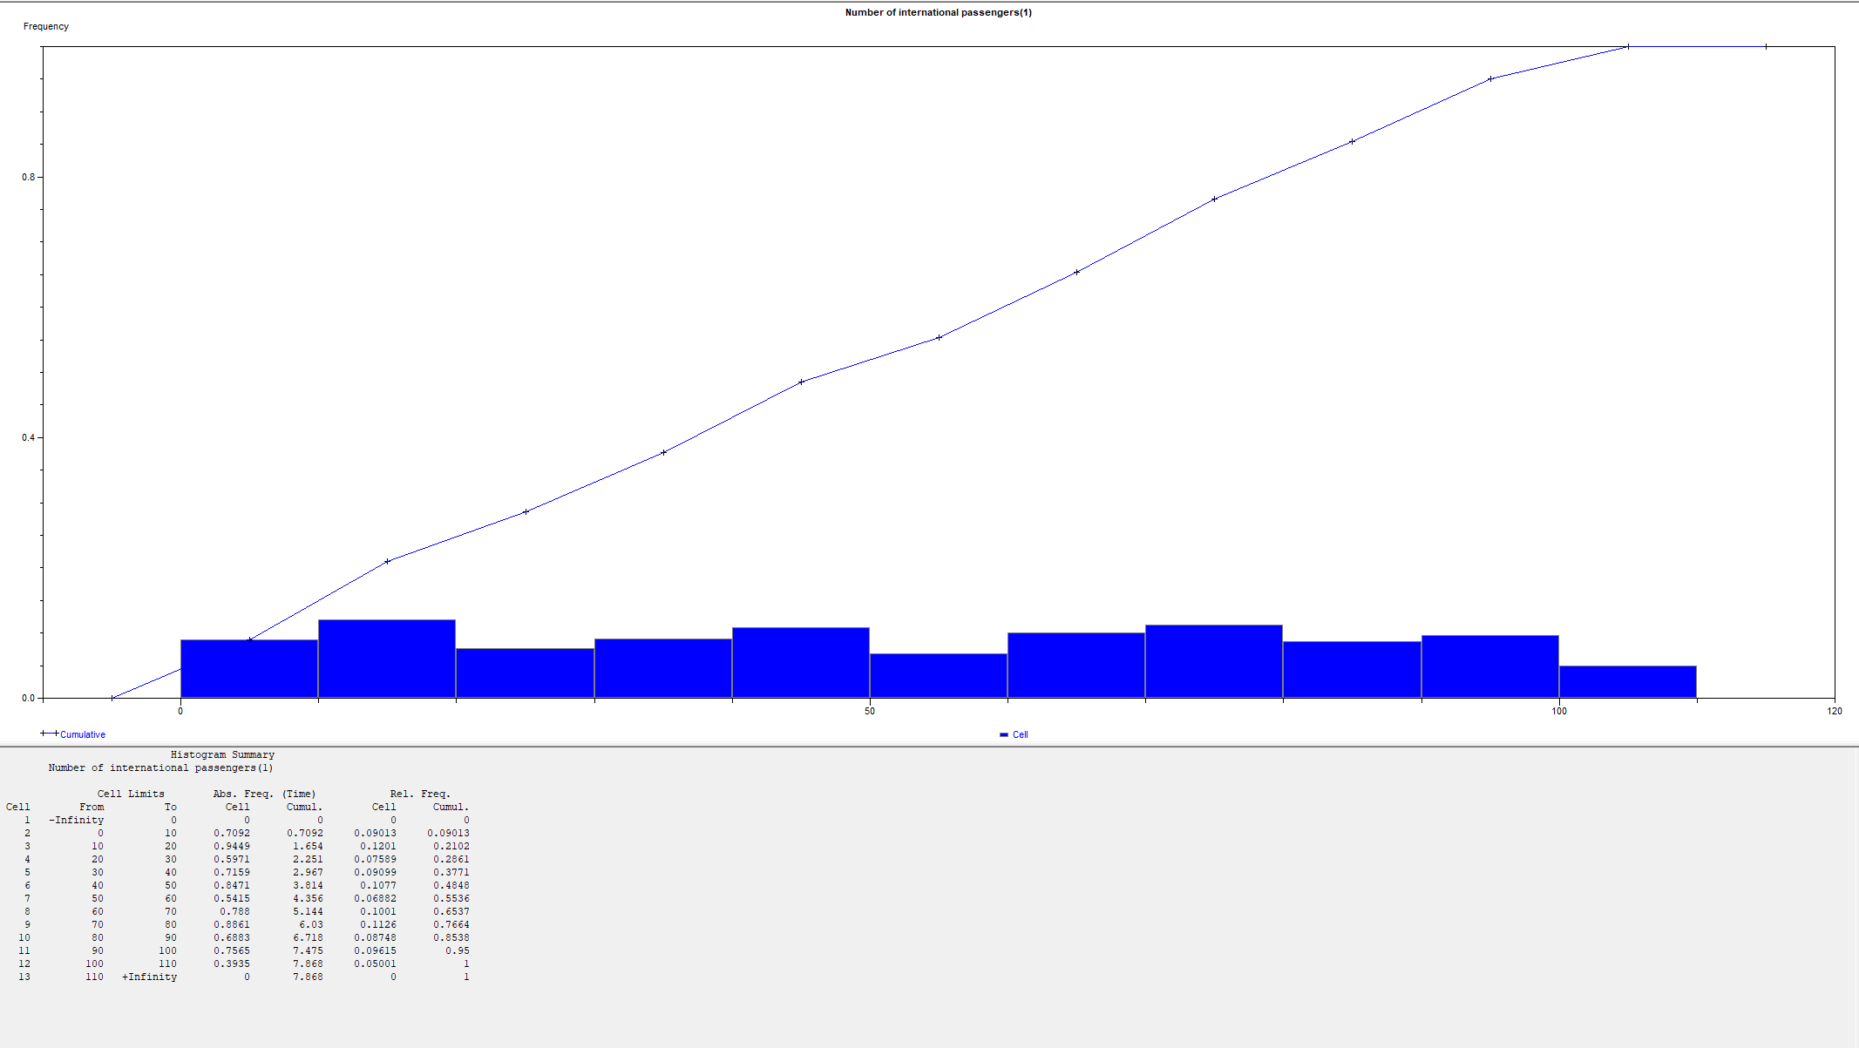
Output analysıs
Number of International Passengers Histogram

Slide 21
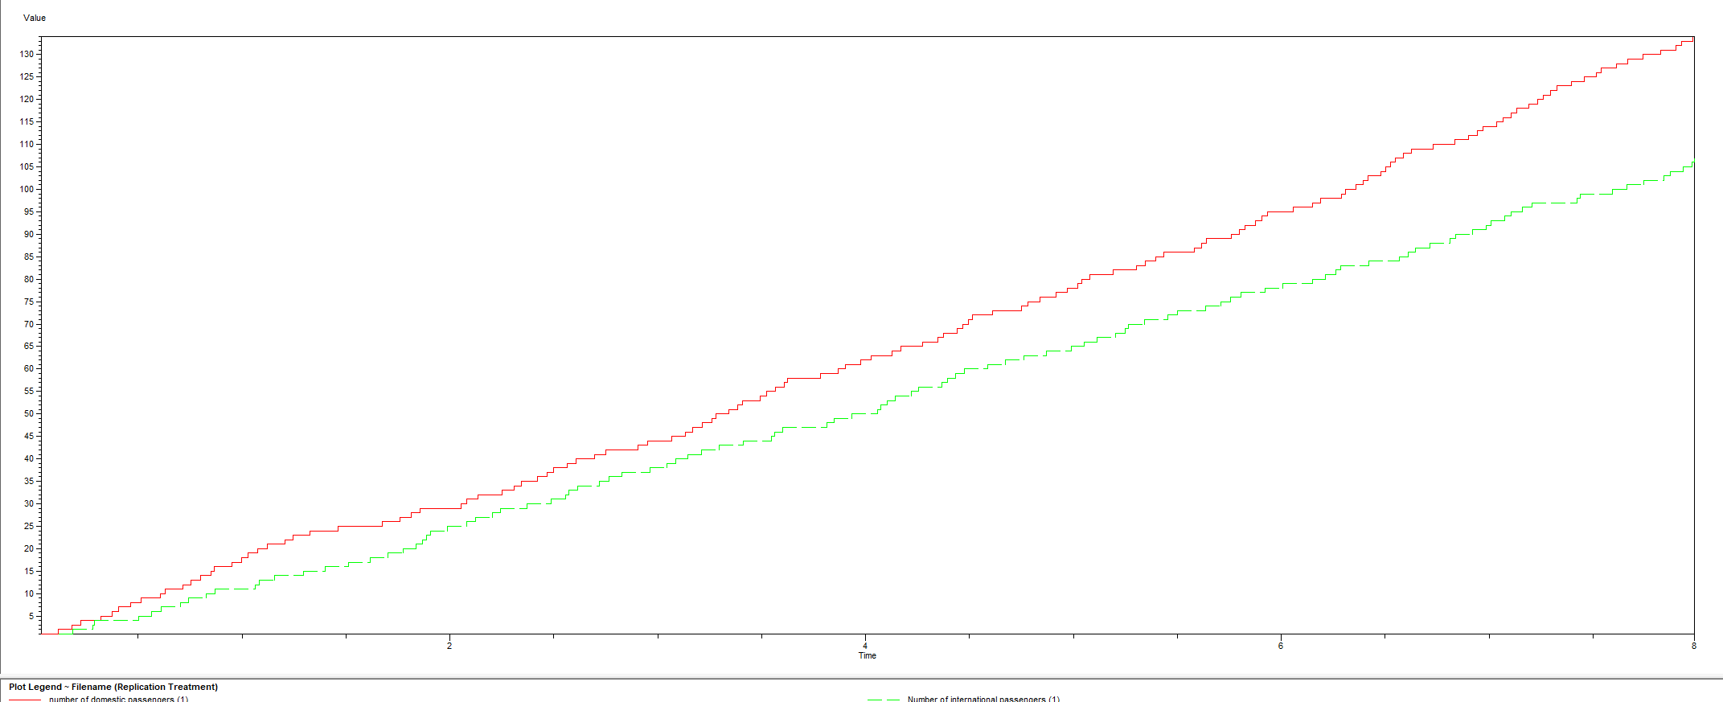
Output analysıs
Comperison of number of international and domestic passengers

Slide 22


